Slide 1
HWA: Hobby-Web-Application Project Car’s and garage’s
Hamza shah

Slide 2
Who am i?
Hamza Shah
BA Finance and Economics Graduate – University Of Hertfordshire
QA Trainee – 21SEPTSOFT pathway

Slide 3
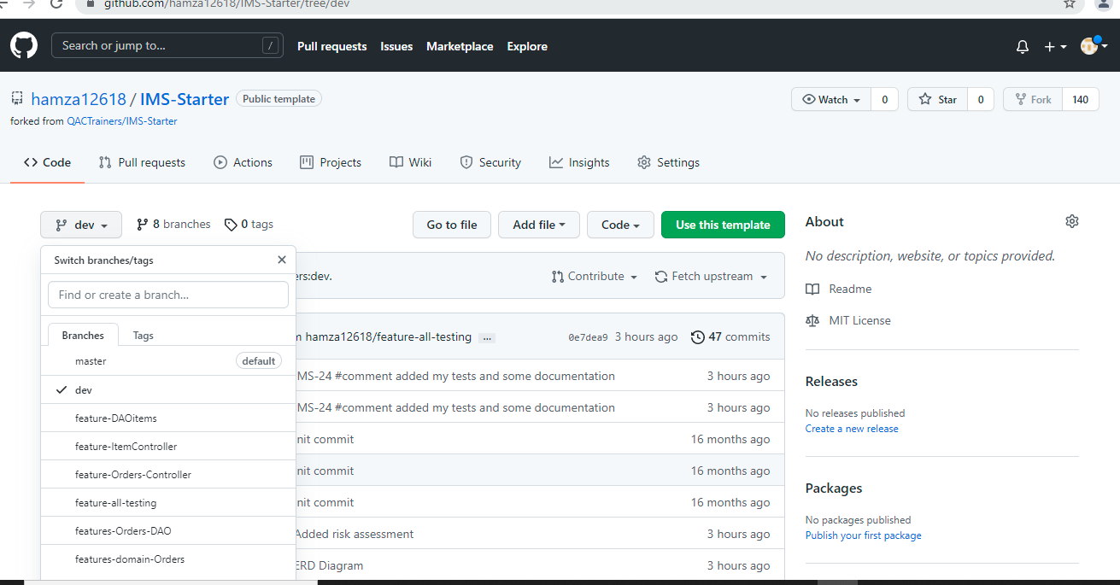
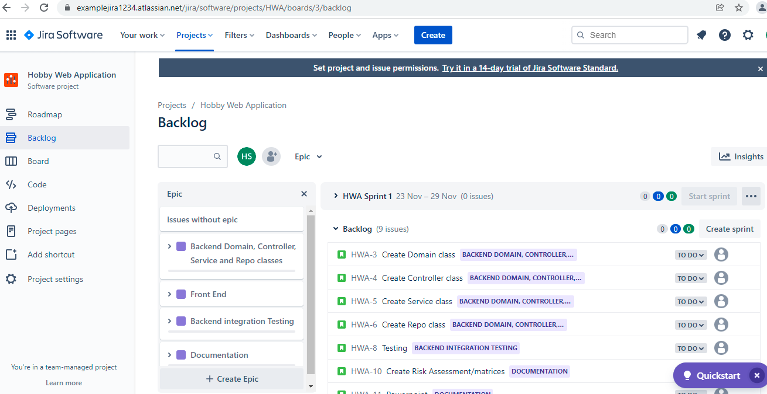
How Did I approach the specification
I started with thoroughly reading through the specification and planning which technologies I needed to use.
Then made a note of the requirements that are being assessed and what the actual project is asking me to do. Created a Kanbad board on Jira with epics and user stories where I assigned myself the tasks as well as ranking them on how long they will take me.
Initialised a ERD diagram for my SQL tables and gave them attributes as well as linked my primary keys + foreign keys. Next created my tables in SQL and began the code within eclipse.

Slide 4
Sprint Plan
What needed to be included?
What I hope to achieve?
User to have a fully functional responsive frontend where they are allowed to carry out the CRUD functions create, read, update and delete for cars/garage’s
A back end api connected to front end via fetch requests and spring boot
Testing aiming for 80% coverage

Slide 5
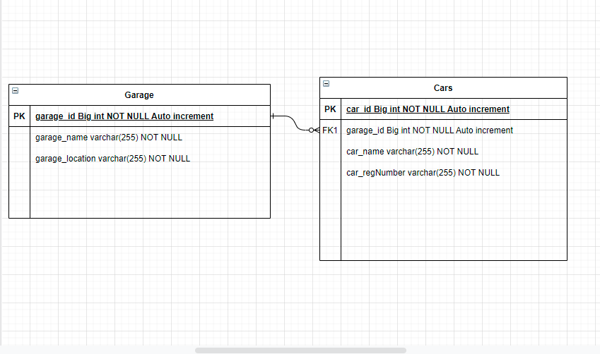
ERD Diagram

Slide 6
Consultant Journey
What technologies have you learned for this project?
Version Control System: Git To pull push and create branches
Source Code Management: GitHub On my repository
Kanban Board: Jira to plan my project and track progress as well as creating epics and user storing
Database Management System: MySQL Server 5.7+ (local or GCP instance) to create a database
Back-End Programming Language: Java on eclipse
Build Tool: Maven, SpringBoot
Unit Testing: Junit for testing, Mockito, Selenium
Front-End Programming Language: HTML, CSS, JAVA SCRIPT

Slide 7
CI: How did you approach version control?
GitHub: Issues, feature/branches, pull requests, push requests, merging feature branches into dev.
I used GitHub as my version control to keep my project on the cloud throughout the sprint making sure I create different feature branches for every different class I work on and merging them into my dev branch without having merge conflicts. I then committed my changes on the project and pulled them into my dev branch by merging them on git hub. This was very helpful in keeping my project in order and helping me keep track of what progress I’ve been making through the sprint.

Slide 8
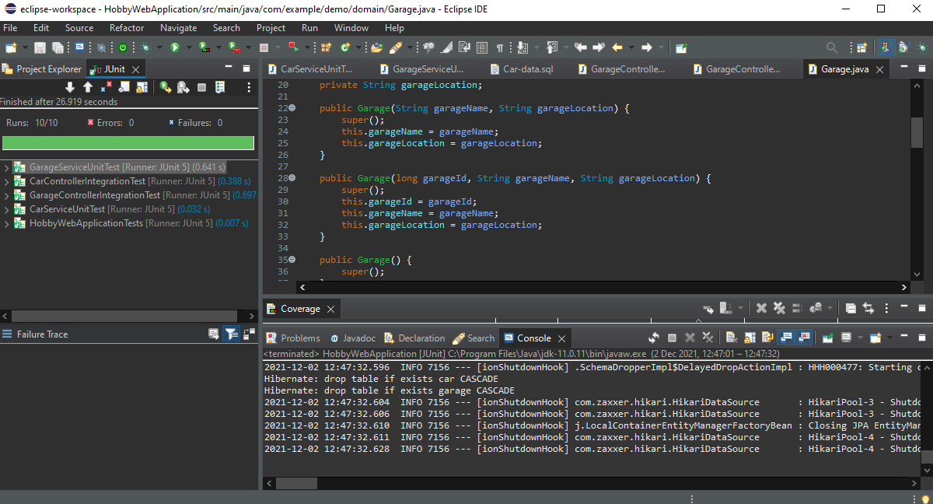
Testing: What was tested? Show the coverage of the src/main/java folder.
I had created 4 tests in total –
Garage Service Unit Test
Garage Controller Integration Test
Car Service Unit Test
Car Controller Integration Test
All 4/4 tests have passed achieving the target which was 80%. However there was a few tests methods which I had to comment out as they were not working and I spent a great amount of time trying to debug.
I had also done manual testing for all my SQL statements which passed.

Slide 9
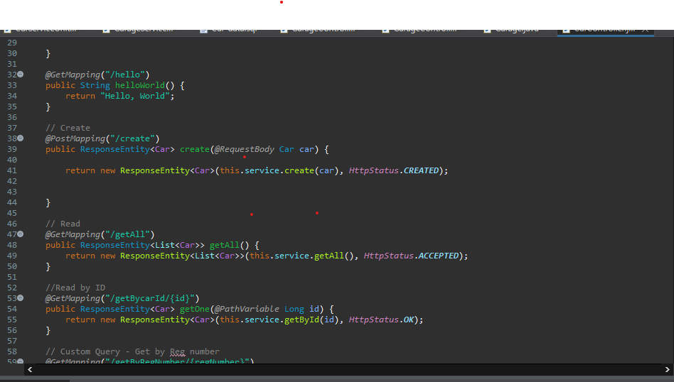
Demonstration: Run through a couple of user stories
I had 4 epics within the Sprint: Backend, Front end, Integration testing and Documentation –Backend which included the Domain, controller, service and repo classes. Within these epics there were many user stories to fulfil the requirements of the specification.
Example User Story1: Create classes and ensure user can carry out CRUD functions. For Cars and garages
This was a very important user story for my HWA project as it is part of the CRUD functionalities which had to be met. Also in a business function you need to be able to carry out CRUD functions.

Slide 10
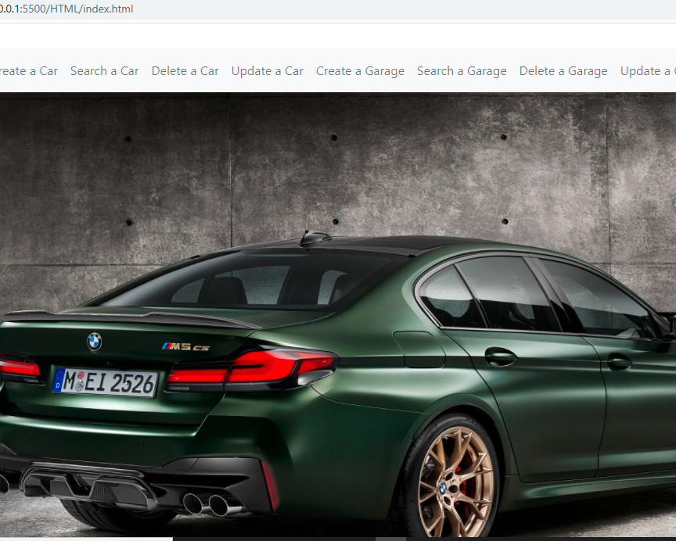
Example User story2:Front end Users should be able to navigate through website and use crud functions
This User story is also part of the CRUD functions where the user would like to use CRUD Functions.
If a software did not allow these basic CRUD functions for a database model it would be non-existent. Similarly to the previous User story this is also very important to create, update, delete and read. As businesses to update new items regularly some items can also be removed and price changes due to inflation must be easy to manipulate on the database.

Slide 11
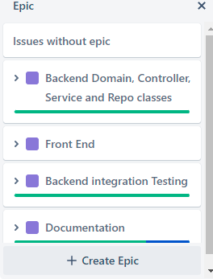
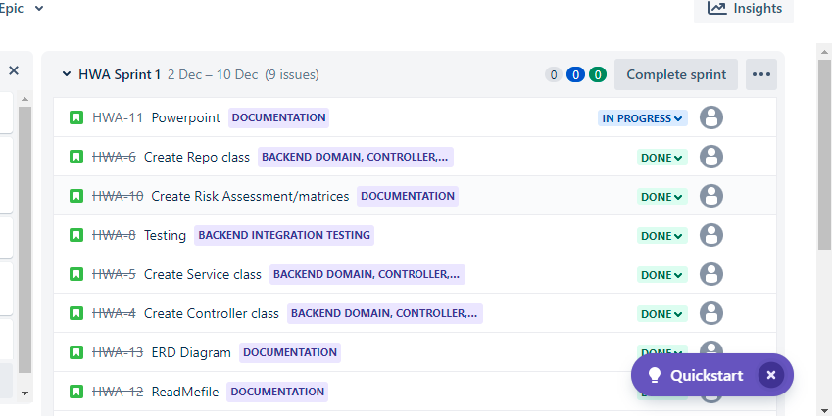

Slide 12
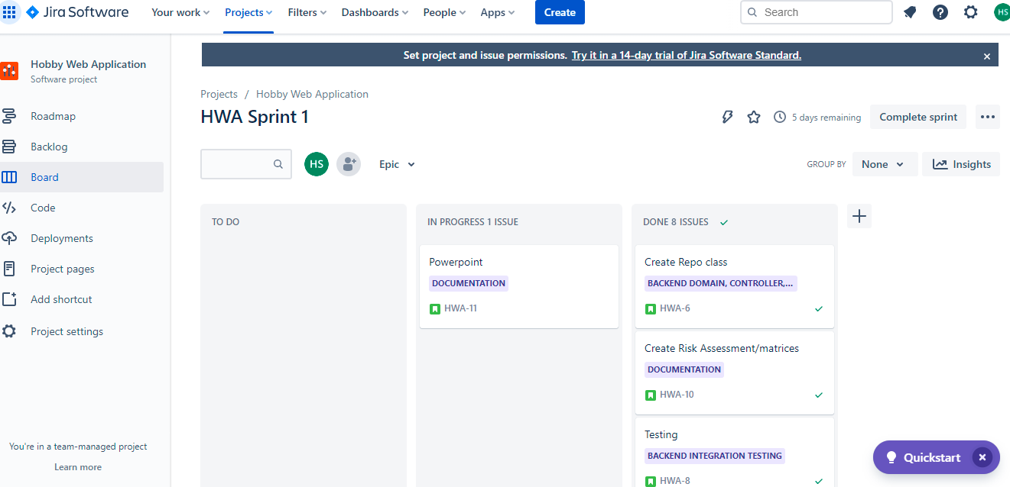
Sprint review: What did you complete? What got left behind?
I have completed all my user stories on Jira for my epics which you can see on my Jira board.
However due to getting a sinus infection it was very difficult for me to keep on track and make branches as I was completing work.

Slide 13

Sprint retrospective: What went well? What could be improved?
Overall the project went well learnt many things on the way and debugging was actually fun. Completed the checklist and lived up to the specification requirements in my personal opinion. However, there would be a few changes I’d make if I was to repeat the project. I’d check after every class I make to check my SQL statements are matching with SQL tables that way I don’t have any errors when doing manual testing and Junit testing.
Although I planned my approach and structure of completing tasks I would still improve it by creating a contingency plan. This Is because when I was debugging my errors it got time consuming and I should’ve gone to the next task and come back to it rather than bashing my head debugging.

Slide 14
Conclusion: Reflections on the project, future steps, any other relevant info
As a whole this project was very engaging and fun to complete as I encountered many debugging opportunities which boosted my confidence. Future steps and precautions I will take would be to make sure small spelling errors are avoided and the fact that my SQL statements are matching with the table content I initially created.
Thanks for listeing!

Slide 15
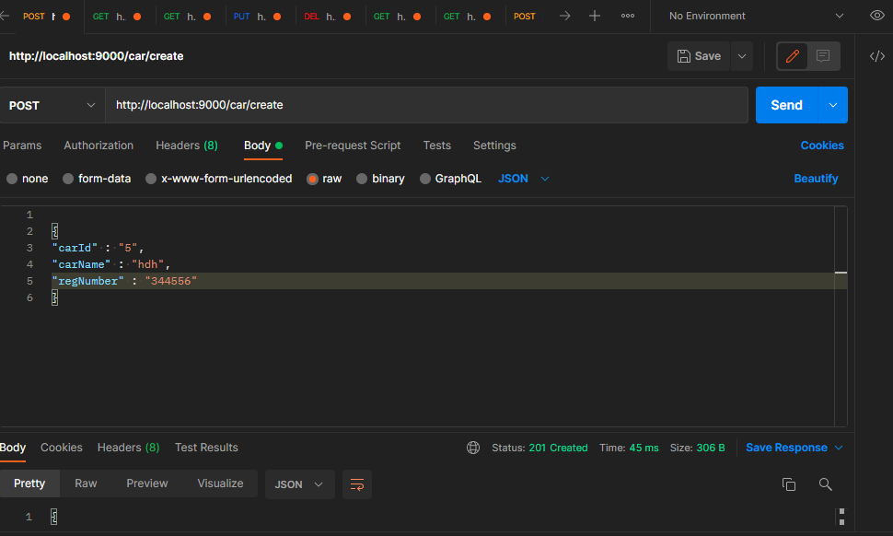
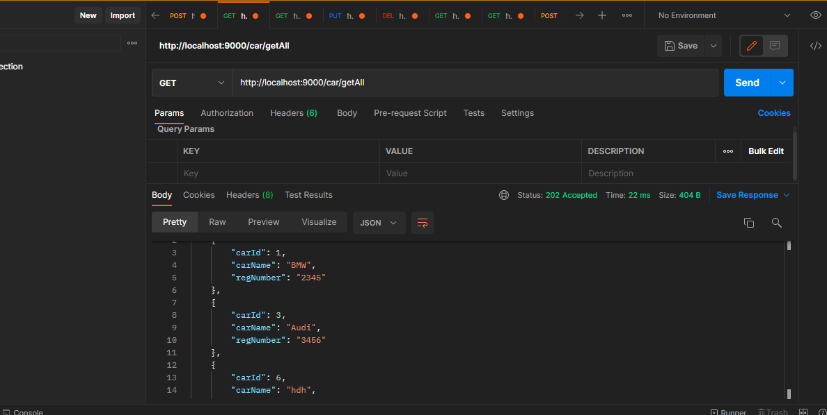
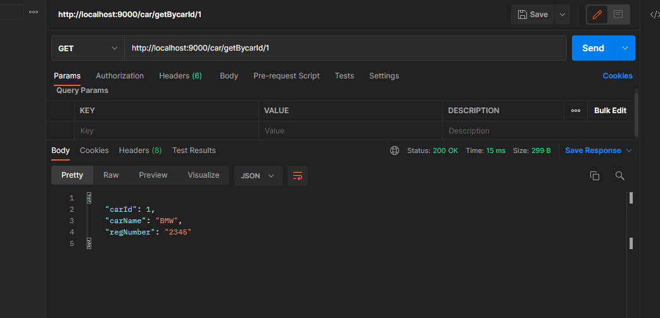
Postman requests

